Slide 1

PROFESSIONAL CERTIFICATE
IN MACHINE LEARNING AND
ARTIFICIAL INTELLIGENCE
Office Hour #22 with
Ali Chaudhry
March 01, 2024 at 3 pm UTC

Slide 2
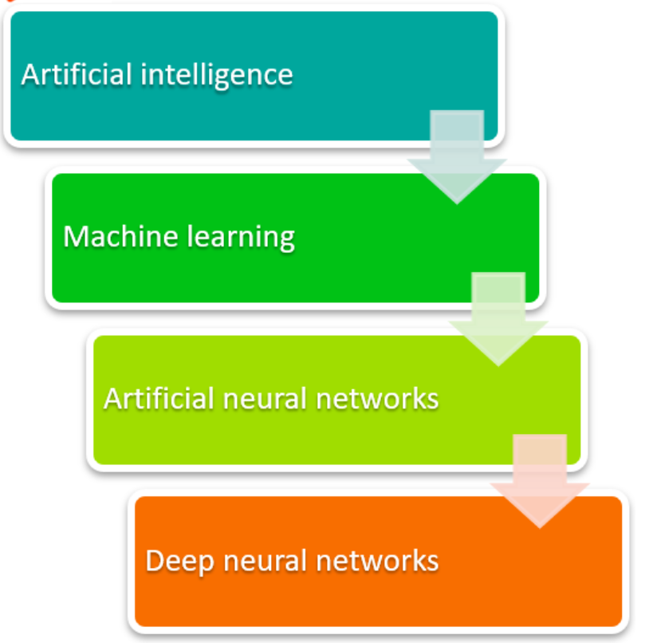
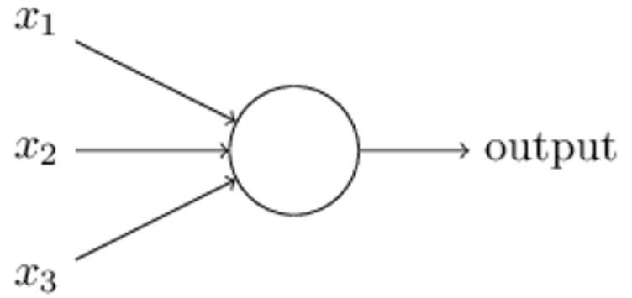
Deep Neural Network
First, machine learning had to get developed. ML is a framework to automate (through algorithms) statistical models to get better at making predictions. A model is a single model that makes predictions about something. Those predictions are made with some accuracy.
Notes:
What’s a Deep Neural Network? Deep Nets Explained – BMC Software | Blogs

Slide 3
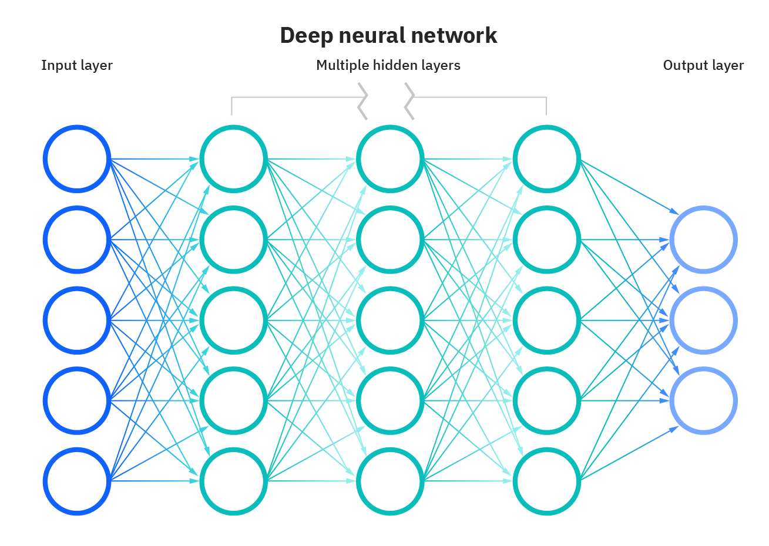
Intro to Deep Learning

Slide 4
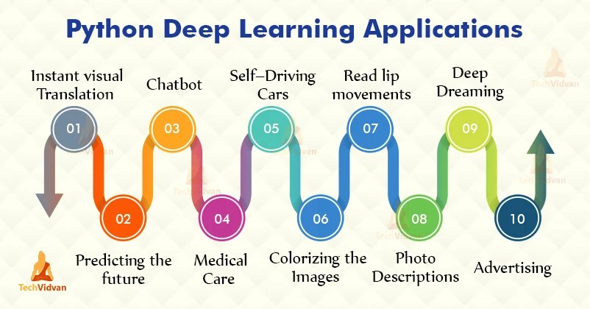
Applications

Slide 5
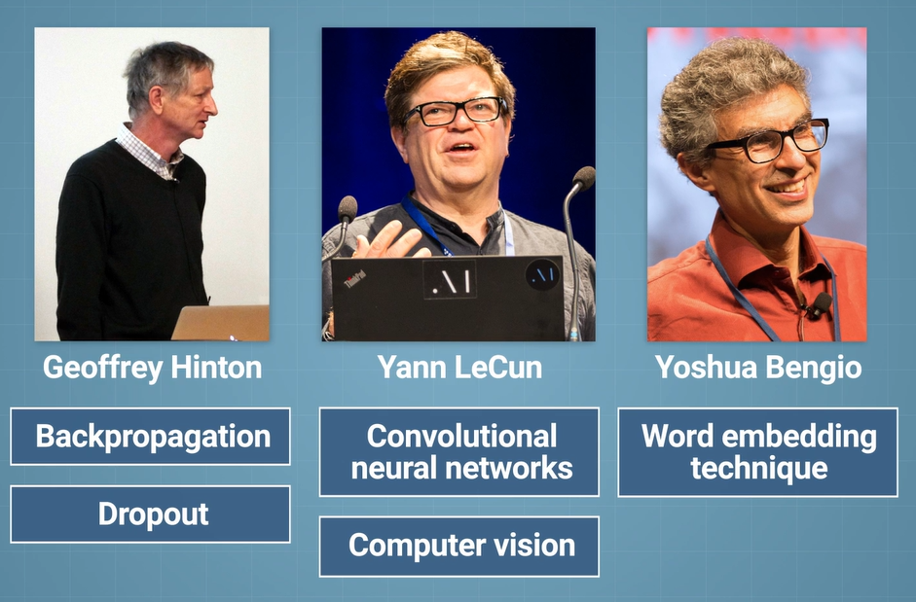
History

Slide 6
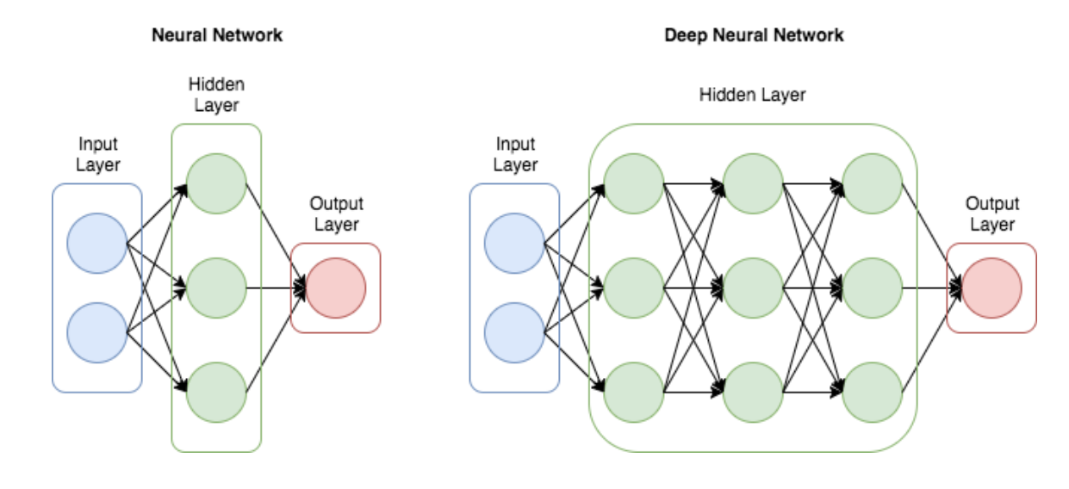
Neural Network - Building blocks
Notes:
8 Applications of Neural Networks | Analytics Steps

Slide 7
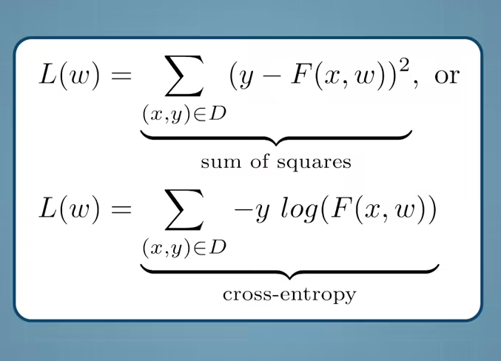
Evaluating Neural Nets
Notes:
What are Hyperparameters ? and How to tune the Hyperparameters in a Deep Neural Network? | by Pranoy Radhakrishnan | Towards Data Science
Neural Networks: parameters, hyperparameters and optimization strategies | by Valentina Alto | Towards Data Science

Slide 8
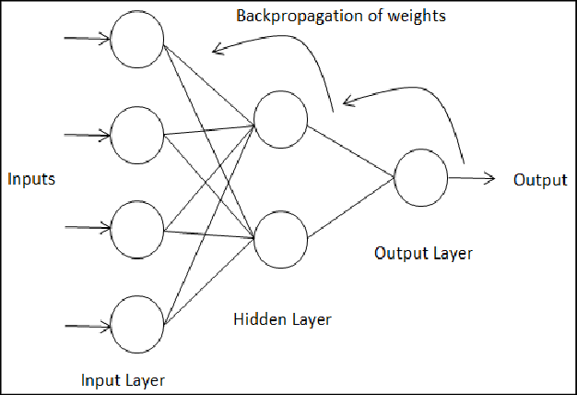
Improving Neural Nets - Backpropagation

Slide 9
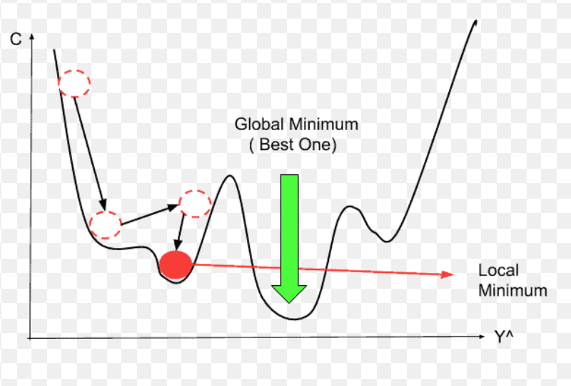
Improving Neural Nets - Stochastic Gradient Descent

Slide 10
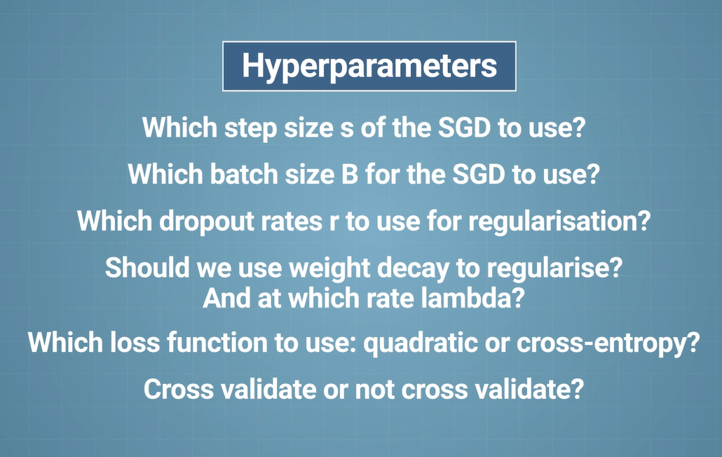
Hyperparameter Optimization
Notes:
Why is Batch Normalization useful in Deep Neural Network? | Towards Data Science

Slide 11

QUESTIONS?

